Slide 1
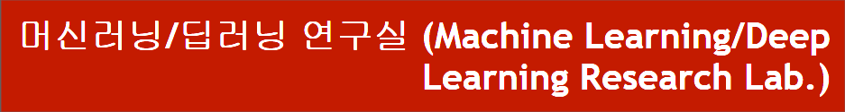
Zen-NAS: A Zero-Shot NAS for High-Performance Image Recognition
Department of Computer Engineering
Dongseo University
Jie Yong Shin,
2023.03.16
Notes:
1

Slide 2
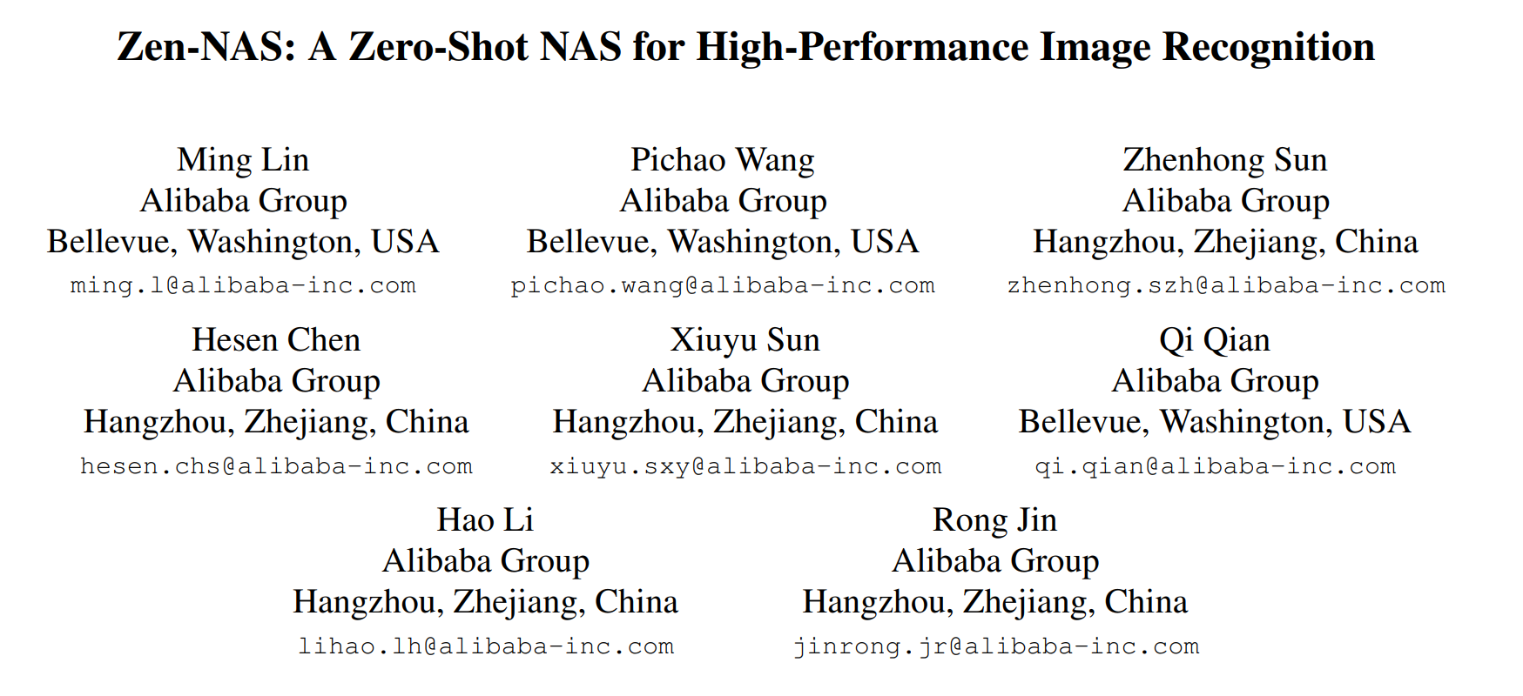
0. Zen-NAS
Published at ICCV on 2021
From Alibaba Group
2
Notes:
2

Slide 3
CONTENTS
Highlights (1)
Φ-score (1)
Zen-score (3)
Zen-NAS (1)
Experiments (1)
Conclusion and further research (1)
3
Notes:
3

Slide 4
1. Highlights
Why did they develop this?
Gaussian complexity(Φ-score) has a numerical overflow problem to be used as a metric for a network's expressivity.
What are contributions of this paper?
They have shown a novel metric to measure a neural network architecture.
They have shown that this metric is faster than the previous metric and can achieve higher accuracy compared to other NAS methods.
They have achieved 83.5% of accuracy with NAS on ImageNet dataset within half of a GPU day.
What are possible improvements?
4
Notes:
4

Slide 5
2. Φ-Score
Vanilla Convolutional Neural Network (VCNN)
Input
Global Average Pooling (GAP)
Convolution
ReLU
1 x 1 x channel
Convolution
Fully Connected Layer
ReLU
Softmax
Pre-Gap Feature map
Prediction
Measure network expressivity
(representation power)
5
A Neurosemantic Theory of Concrete Noun Representation Based on the Underlying Brain Codes
Notes:
5

Slide 6
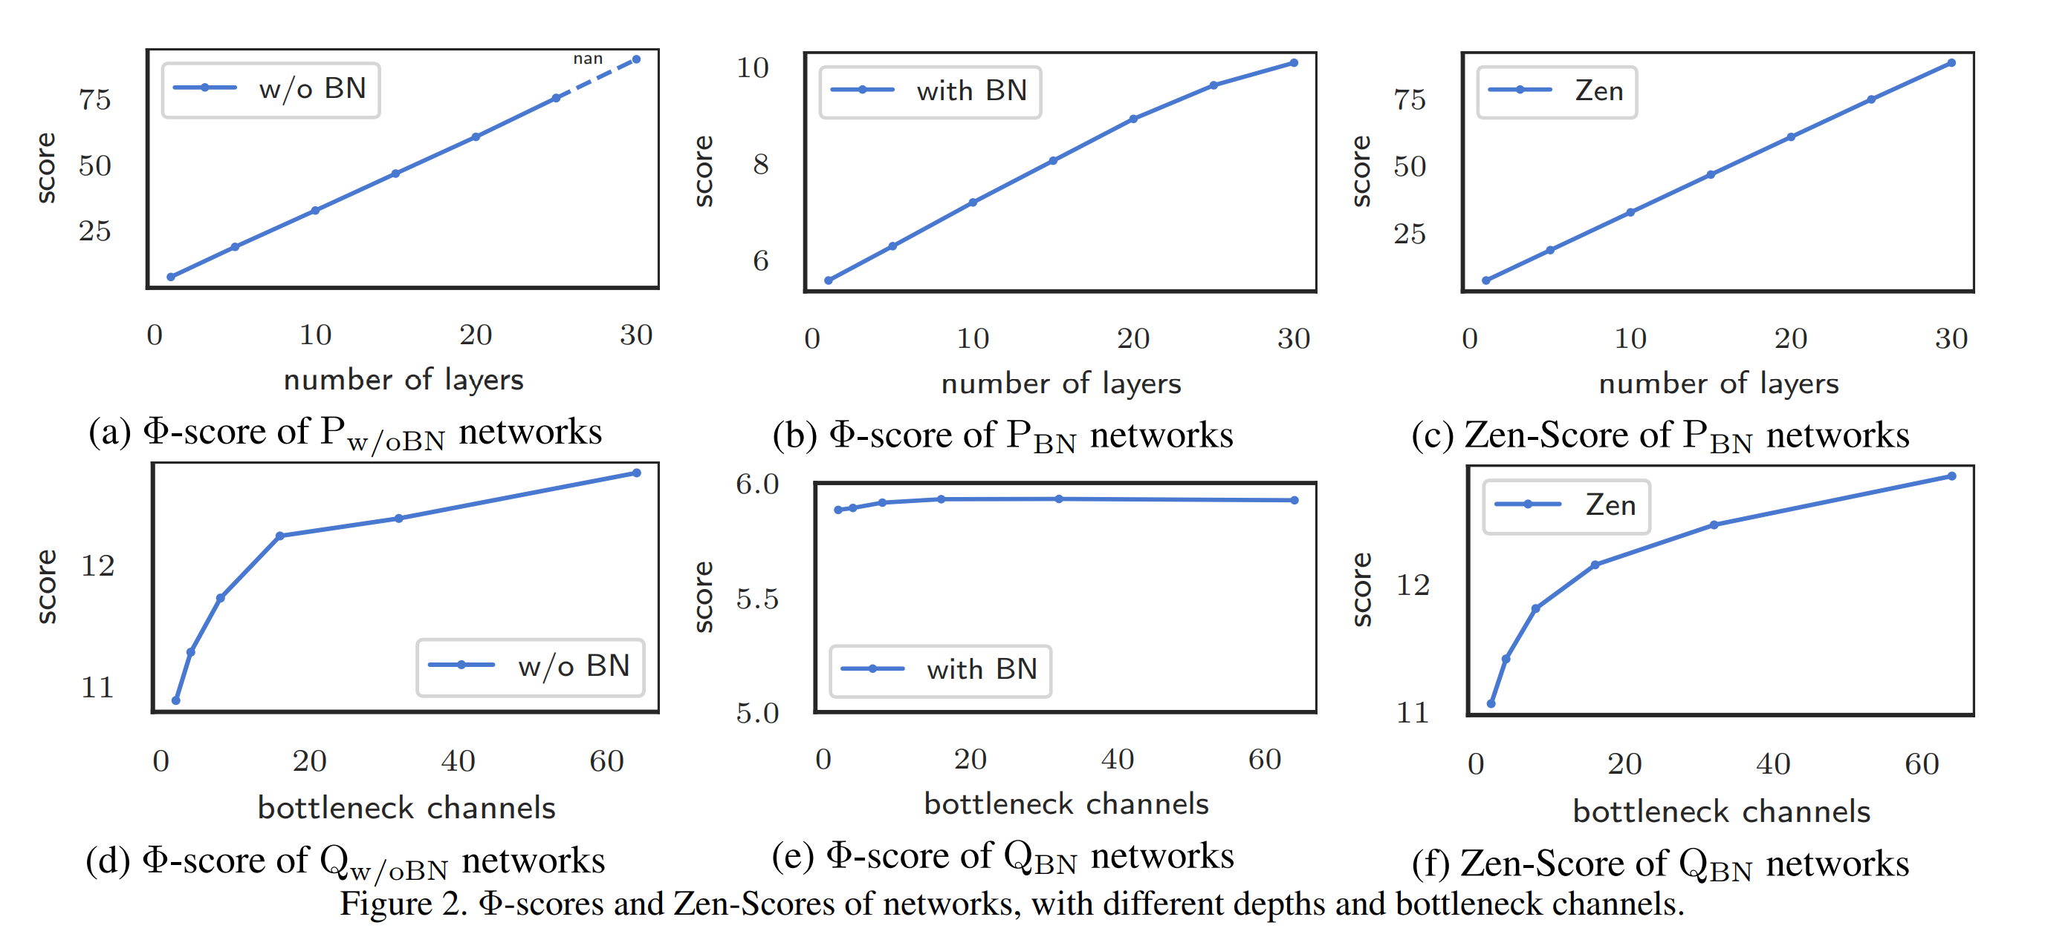
3. Zen-Score
Difference between Φ-Score and Zen-Score
When it comes to bottleneck channels with BN, Gaussian complexity(Φ-score) incurs numerical overflow
Zen-Score removes BN and then calculate Φ-score
6
A Neurosemantic Theory of Concrete Noun Representation Based on the Underlying Brain Codes
Notes:
5

Slide 7
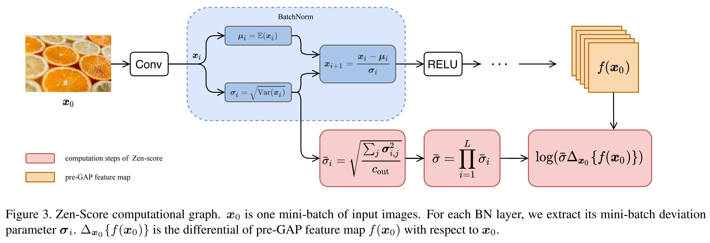
3. Zen-Score
5
7
Zen-NAS: A Zero-Shot NAS for High-Performance Image Recognition
Notes:
6

Slide 8
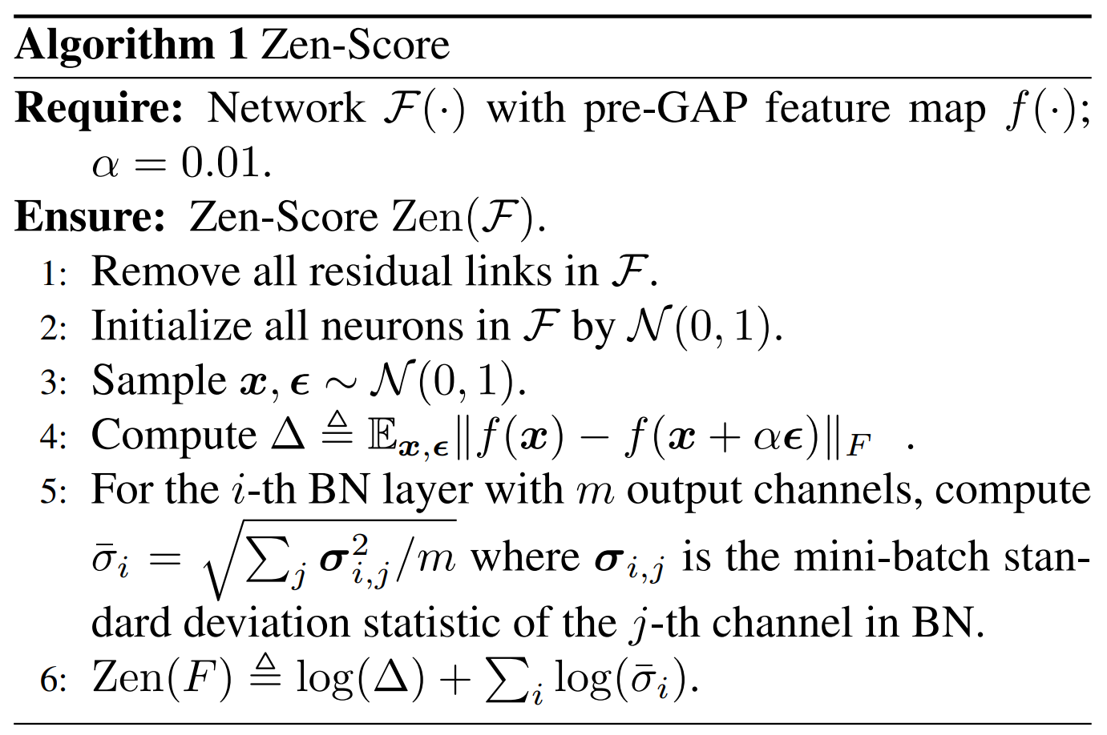
3. Zen-Score
All residual links are removed as pre-processing
Sample input vector and perturb with Gaussian noise
Δ : Perturbation (replaces gradient of x)
The Zen-Score of network with BN layers approximates the Φ-score of the same network without BN layers
6
8
Zen-NAS: A Zero-Shot NAS for High-Performance Image Recognition
Notes:
7

Slide 9
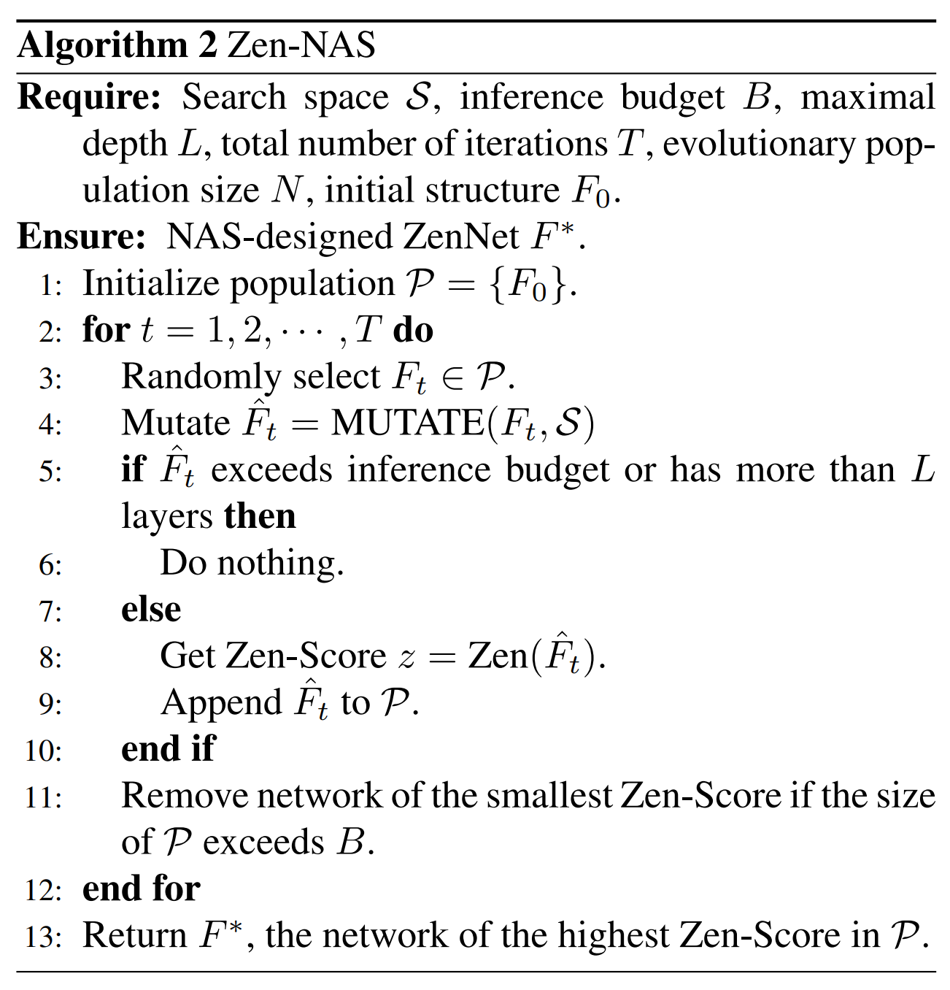
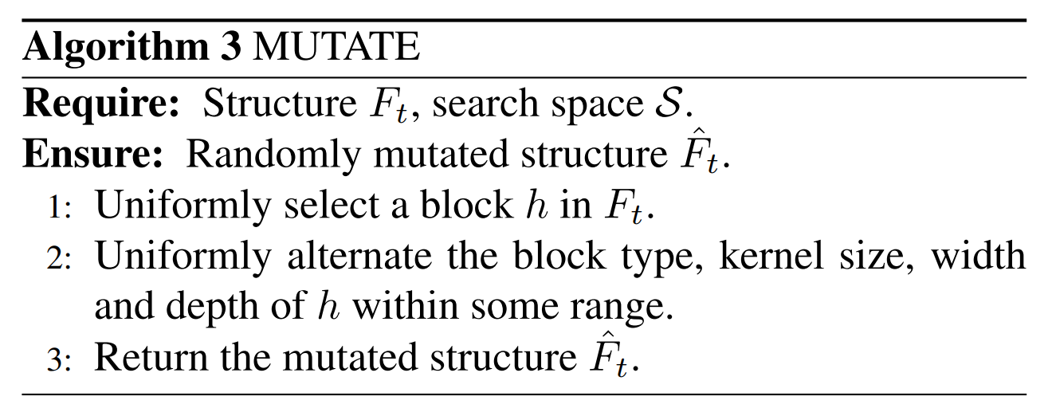

3. Zen-NAS
Inference cost < Budget
Maximal depth < L
Remove lowest Zen-Score individuals
7
9
Zen-NAS: A Zero-Shot NAS for High-Performance Image Recognition
Notes:
8

Slide 10
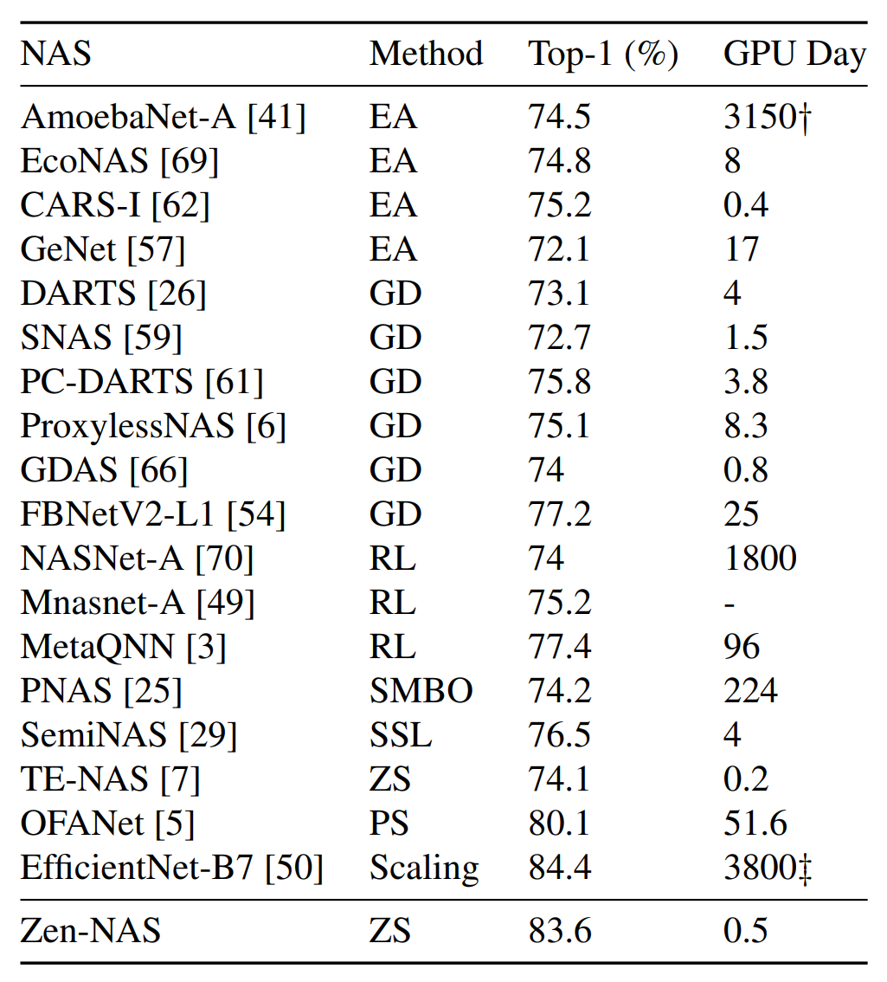
4. Experiments
Neural Architecture Search on ImageNet
8
10
Zen-NAS: A Zero-Shot NAS for High-Performance Image Recognition
Notes:
9

Slide 11
5. Conclusion and Further research
They have a new metric (Zen-Score) from previous studies (Zero-Shot proxy).
By using Zen-Score, they have achieved State-Of-The-Art (SOTA) in ImageNet dataset.
Research about the Zero-Shot proxy.
According to them, RL based method can be implemented with Zen-Score.
In the algorithm, they do not keep the elite. By keeping the elite, it can have higher accuracy.
9
11
Zen-NAS: A Zero-Shot NAS for High-Performance Image Recognition
Notes:
10

Slide 12
References
Zen-NAS: A Zero-Shot NAS for High-Performance Deep Image Recognition https://paperswithcode.com/paper/zen-nas-a-zero-shot-nas-for-high-performance
Zero-Cost Proxies for Lightweight NAS
https://arxiv.org/abs/2101.08134
EfficientNet: Rethinking Model Scaling for Convolutional Neural Networks https://arxiv.org/abs/1905.11946
Neural Architecture Search on ImageNet in Four GPU Hours: A Theoretically Inspired Perspective (TE-NAS)
https://arxiv.org/abs/2102.11535
10
Notes:
11

Slide 13
Thank you
Q & A
Notes:
-
The training of procedure for is to maximize the probability of D making a mistake. This framework corresponds to a minimax two-player game.
In the space of arbitrary functions G and D, a unique solution exists, with G recovering the training data distribution and D equal to ½ everywhere.
12

Slide 14
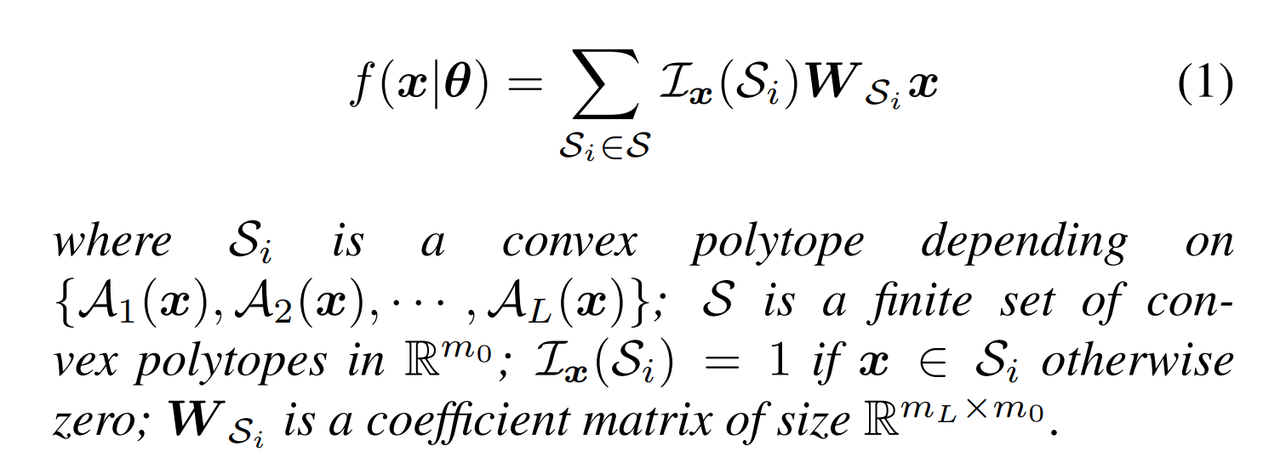
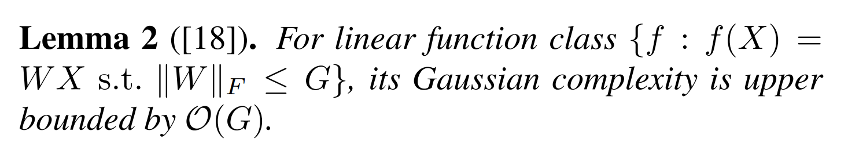
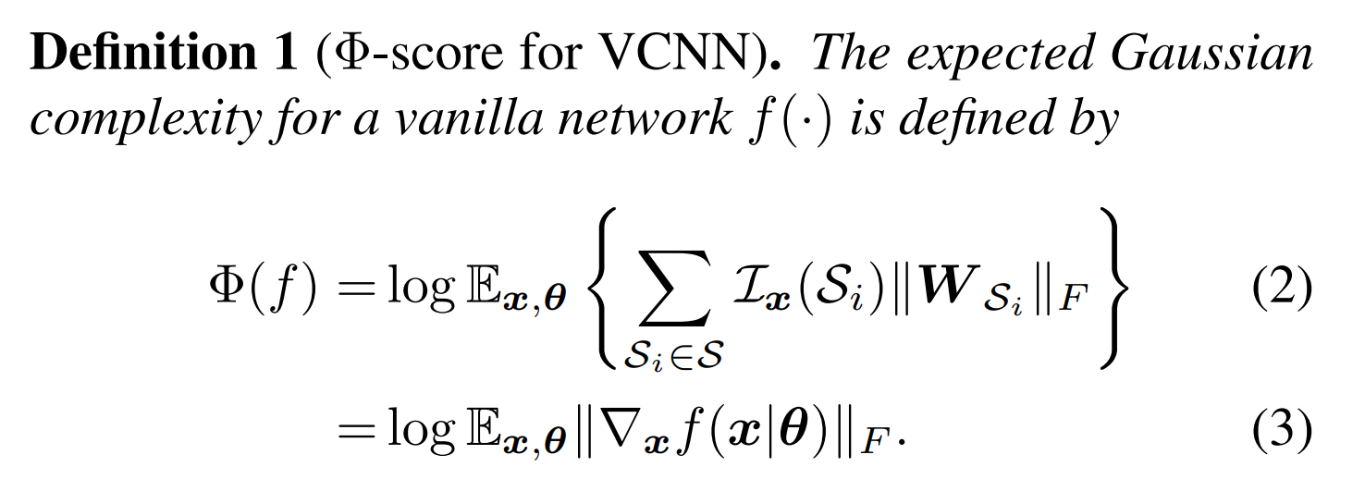
2. Φ-Score
Gaussian complexity is being used as a method to calculate the representation power of a network.
14
A Neurosemantic Theory of Concrete Noun Representation Based on the Underlying Brain Codes
Notes:
6

Slide 15
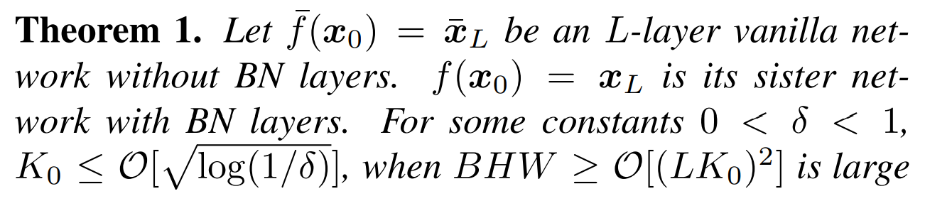
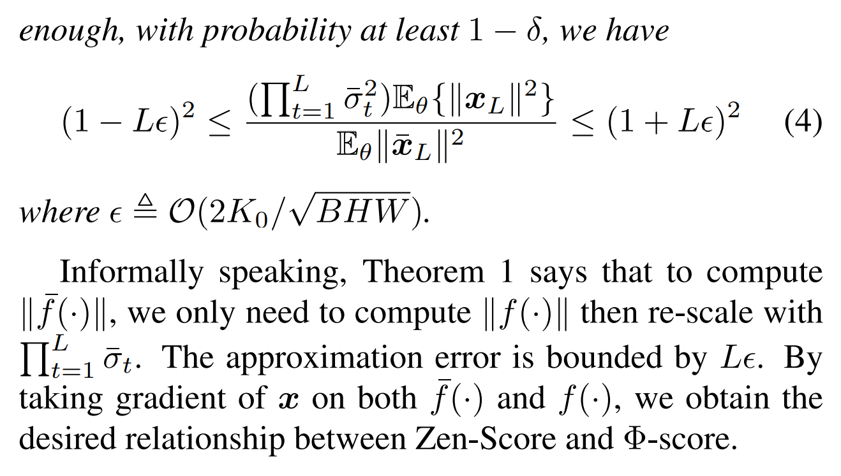
2. Φ-Score
Zen-Score of a network approximates Φ-score
15
A Neurosemantic Theory of Concrete Noun Representation Based on the Underlying Brain Codes
Notes:
14

Slide 16
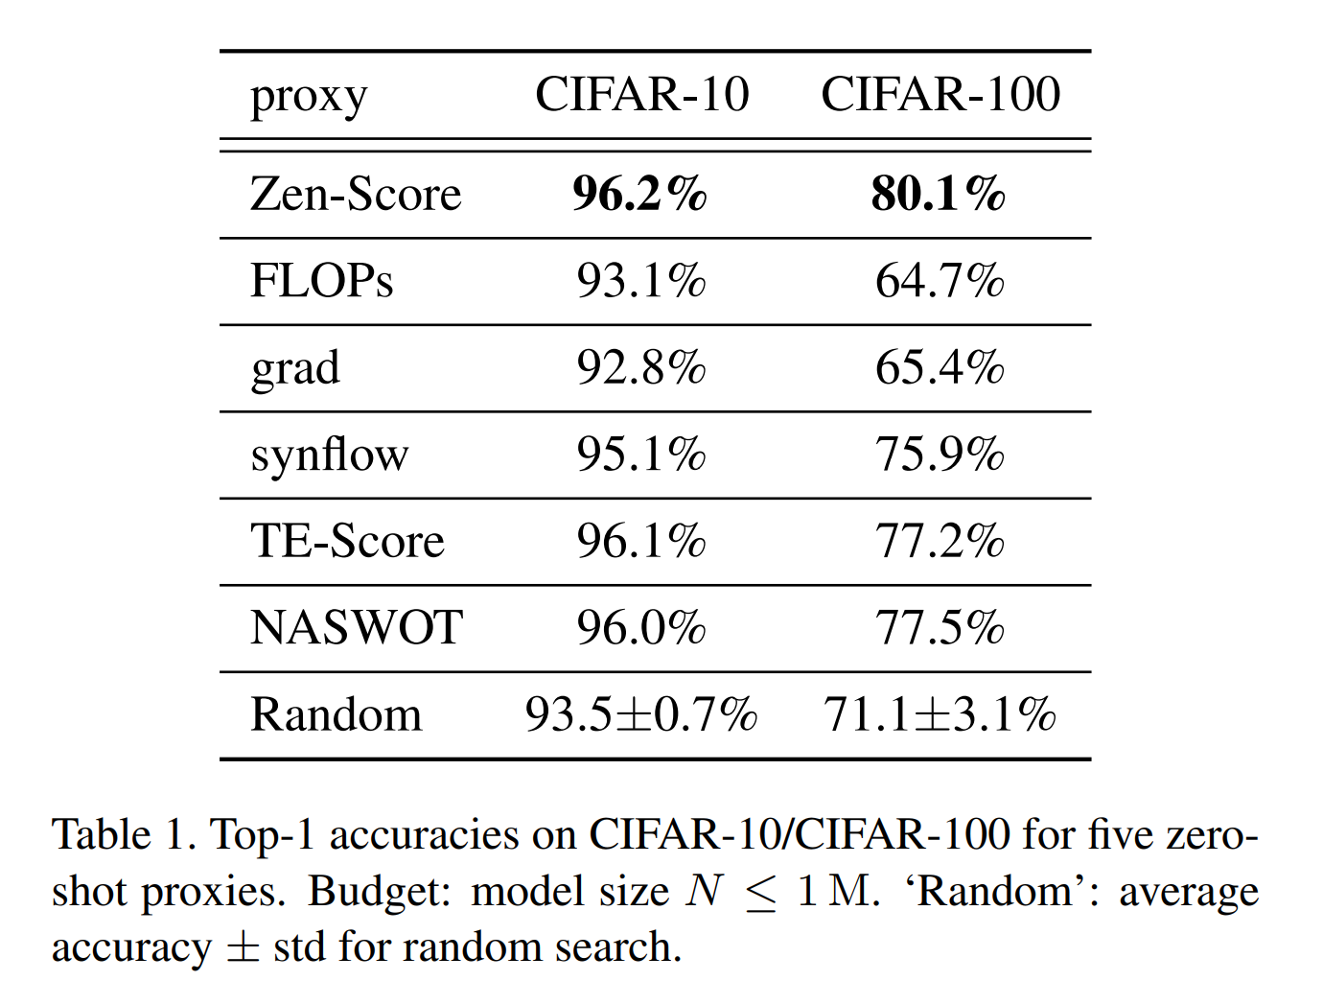
4. Experiments
Zen-Score with other metrics
8
16
Zen-NAS: A Zero-Shot NAS for High-Performance Image Recognition
Notes:
13

Slide 17
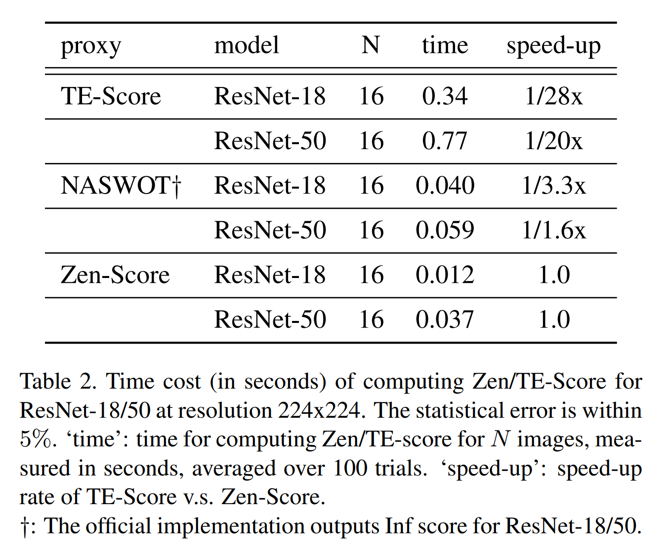
4. Experiments
Zen-Score with other Zero-Shot Proxies
8
17
Zen-NAS: A Zero-Shot NAS for High-Performance Image Recognition
Notes:
15

Slide 18
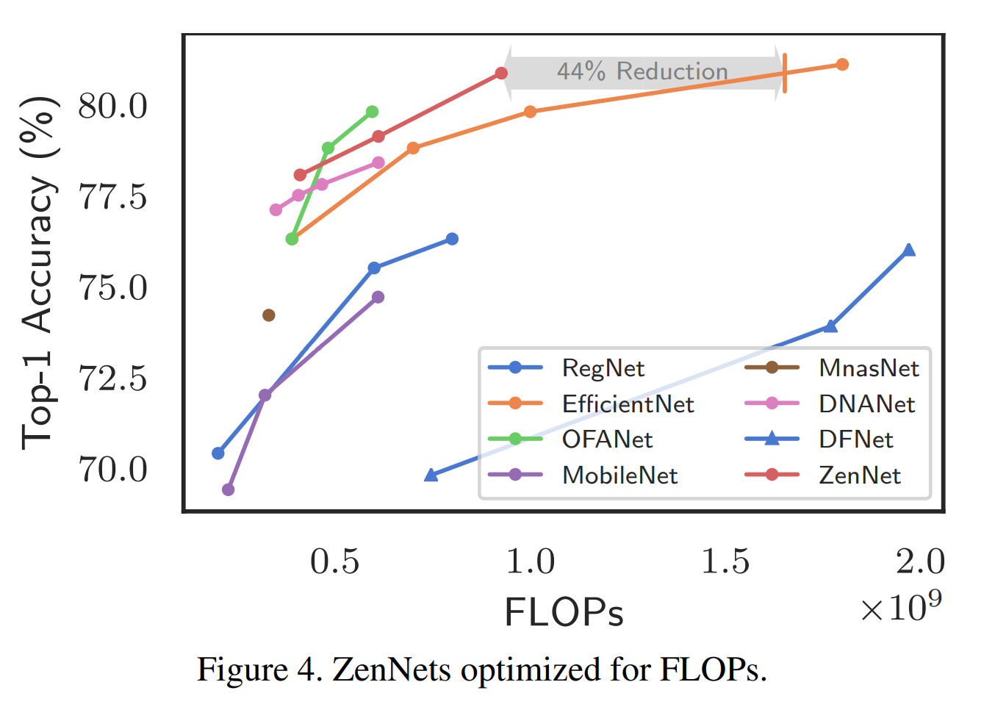
4. Experiments
Comparison with the limit of FLOPs
8
18
Zen-NAS: A Zero-Shot NAS for High-Performance Image Recognition
Notes:
16

Slide 19
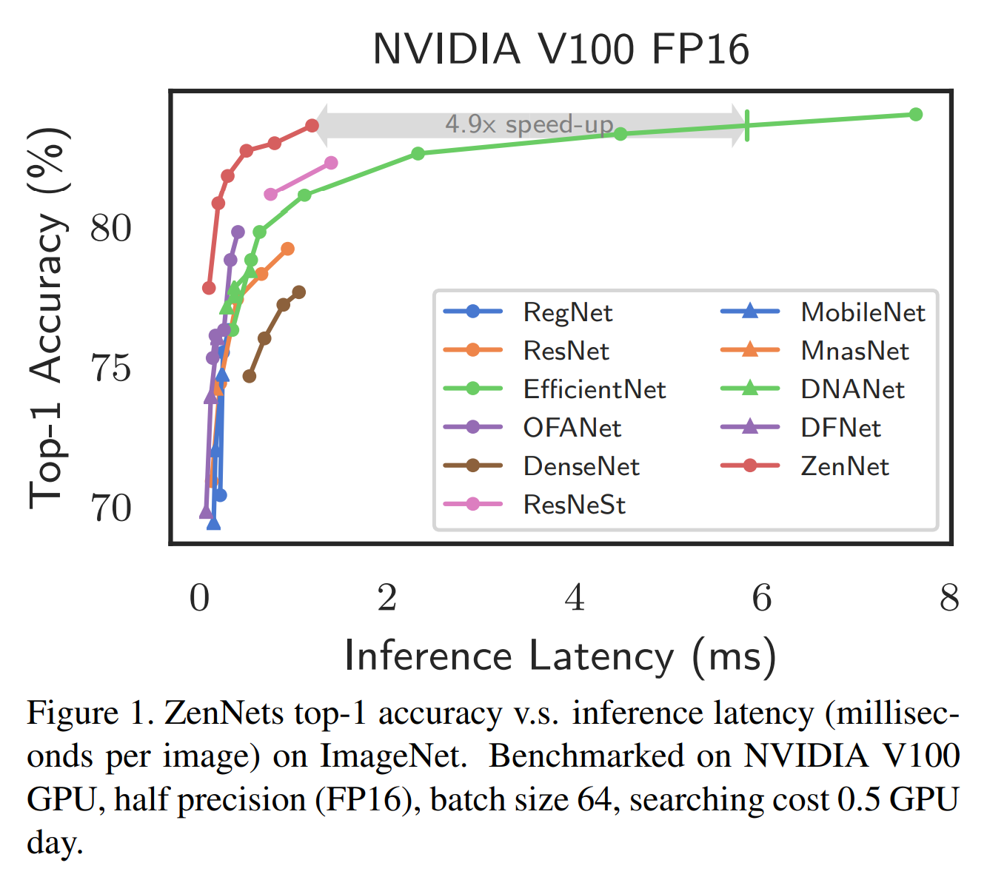
4. Experiments
Comparison with other NAS algorithms
8
19
Zen-NAS: A Zero-Shot NAS for High-Performance Image Recognition
Notes:
17

